Slide 1



AI-POWERED SMART STUDY PLANNER USING WEIGHTED PRIORITY ALGORITHM
Guided By,
Mrs VALLI PRIYADHARSHINI K
M.E (Phd)
Assistant Professor, CSE
Presented By,
811722104155 – SRINIVAS J G
811722104156 – SRIRAM G
811722104157 – SUBBIAH KARTHICK S
11/06/2025

Slide 2

ABSTRACT
To generate a personalized and effective study schedule for students using an AI-powered system based on a Weighted Priority Algorithm.
The planner distributes study hours by analyzing subject difficulty, subtopic complexity, and time remaining before exams.
It provides an optimized study plan that enhances time management and academic performance.
11/06/2025

Slide 3
OBJECTIVE
Develop a web-based application for effective study planning and time management.
Enable students to create and customize study schedules based on their goals.
Provide automated reminders and progress tracking to enhance productivity.
Optimize study sessions with smart recommendations based on deadlines and priorities.
11/06/2025

Slide 4
LITERATURE SURVEY
S.No. | Paper Title | Year | Remark
1 | Intelligent Study Planning Systems Using Machine Learning, Kumar et al | 2023 | Highlights a machine learning-based approach for personalized study planning and improved time management.
2 | Weighted Priority Algorithms for Efficient Task Scheduling, Lee and Park | 2023 | Presents a weighted priority algorithm to optimize task scheduling based on urgency and importance.
3 | Adaptive Learning Systems Based on Historical Data and Feedback, Kim and Choi | 2023 | Discusses adaptive learning systems that personalize study plans using historical performance and real-time user feedback.
11/06/2025

Slide 5
LITERATURE SURVEY
S.No. | Paper Title | Year | Remark
4 | Effectiveness of Mobile Notification Systems in Enhancing Study Compliance, Ahmed and Yusuf | 2023 | Highlights how timely mobile notifications can significantly improve student adherence to study schedules and task completion.
5 | Integration of Natural Language Processing for User Interaction, Singh and Patel | 2023 | Emphasizes the role of NLP in enabling intuitive, conversational user interactions, improving usability and engagement in study planning systems.
6 | Gamification as a Motivation Enhancer in Learning Platforms, Chen and Wang | 2022 | Highlights how gamification boosts user motivation and engagement, making learning platforms more effective.
11/06/2025

Slide 6
LITERATURE SURVEY
S.No. | Paper Title | Year | Remark
7 | Data Visualization for Monitoring Academic Progress, Al-Mansour and Al-Ahmari | 2022 | Emphasizes the role of data visualization in tracking academic performance, enabling better decision-making for learners.
8 | Multi-device Synchronization for Seamless Study Plan Management, Roberts and Kim | 2022 | Highlights the importance of synchronizing data across devices to ensure seamless access and management of study plans anytime, anywhere.
9 | Task Scheduling Algorithms in Cloud Computing, Ibrahim Mahmood | 2021 | Provides a comparative analysis of task scheduling techniques in cloud environments, laying a foundation for efficient and priority-based task allocation strategies.
11/06/2025

Slide 7
EXISTING SYSTEM
Intelligent Scheduling:
Automatically organizes events, meetings, and tasks, ensuring efficient time management.
Real-Time Synchronization:
Updates events instantly across multiple devices, keeping schedules accessible anytime.
Automated Reminders & Alerts:
Sends notifications for upcoming tasks, deadlines, and meetings to enhance productivity.
Cross-Platform Accessibility:
Seamlessly integrates with mobile, web, and desktop applications for flexible usage.
11/06/2025

Slide 8
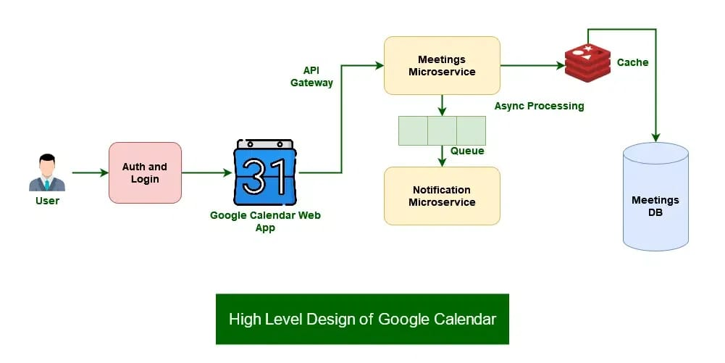
SYSTEM ARCHITECTURE
11/06/2025

Slide 9
PROPOSED SYSTEM
Key Features:
Generates personalized study plans using a Weighted Priority Algorithm.
Allows students to input subjects, subtopics, deadlines, and free hours.
How It Works?
Students enter subject details, subtopics, and their available study time.
The system assigns weights to topics based on importance and urgency.
A study schedule is auto-generated, optimized for time and topic priority.
Benefits:
Ensures effective time management and focused preparation.
Reduces exam stress and Improves academic performance through strategic and consistent planning.
11/06/2025

Slide 10
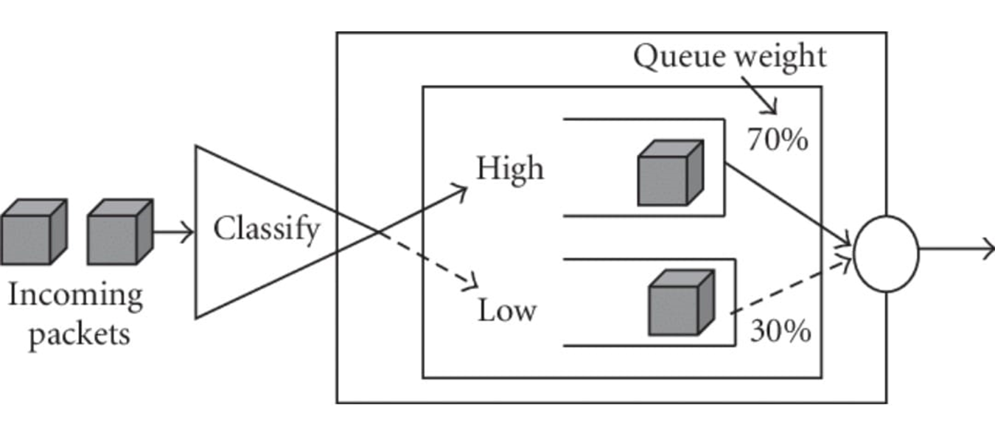
SYSTEM ARCHITECTURE
11/06/2025

Slide 11
MODULES
To design a Smart Study Planner, the project can be divided into 5 key modules.
Project Modules:-
User and Study Data Management
Study Plan Generation
Study Plan Display & Management
Notifications and Reminders
Export and Report Generation
11/06/2025

Slide 12
MODULE 1 : User and Study Data Management
Subject & Exam Data Entry – Users input subjects, exam dates, and difficulty levels.
Study Hour Allocation Input – Users specify available study hours for personalized planning.
Local Data Storage – Study plans are stored using SQLite or SharedPreferences for offline access.
Data Validation – Ensures valid exam dates and difficulty levels before processing.
11/06/2025

Slide 13
MODULE 2 : Study Plan Generation
Calculate Days Left – Determines the number of days remaining until each exam.
Prioritize Subjects – Assigns priority based on exam date and difficulty level.
Dynamic Study Hour Allocation – Distributes available study hours using a weighted formula.
Real-Time Study Plan Updates – Adjusts study schedules dynamically based on new inputs.
11/06/2025

Slide 14
MODULE 3 : Study Plan Display and Management
View and Track Study Plan – Displays allocated study hours for each subject in a structured format.
Edit and Update Study Plan– Allows users to modify subjects, exam dates, and available study hours.
Manage Study Priorities – Adjusts study schedules dynamically based on changing inputs.
Delete and Reset Study Plan – Provides options to clear or reset the generated study plan as needed.
11/06/2025

Slide 15
MODULE 4 : Notifications and Reminders
Study Session Reminders – Sends alerts for upcoming study sessions based on the generated plan.
Exam Countdown Notifications – Notifies users about approaching exam dates to ensure timely preparation.
Study Plan Updates – Alerts users when they modify subjects, difficulty levels, or study hours.
Daily & Weekly Study Summaries – Provides progress updates to keep users on track.
11/06/2025

Slide 16
MODULE 5 : Export and Report Generation
Generate and View Study Plans – Allows users to access detailed study schedules.
Export Study Plans as PDF – Enables easy sharing and offline access to study schedules.
Study Progress Reports – Provides insights into allocated study hours and upcoming exams.
Custom Filters for Reports – Users can filter reports based on subjects, exam dates, or difficulty levels.
11/06/2025

Slide 17
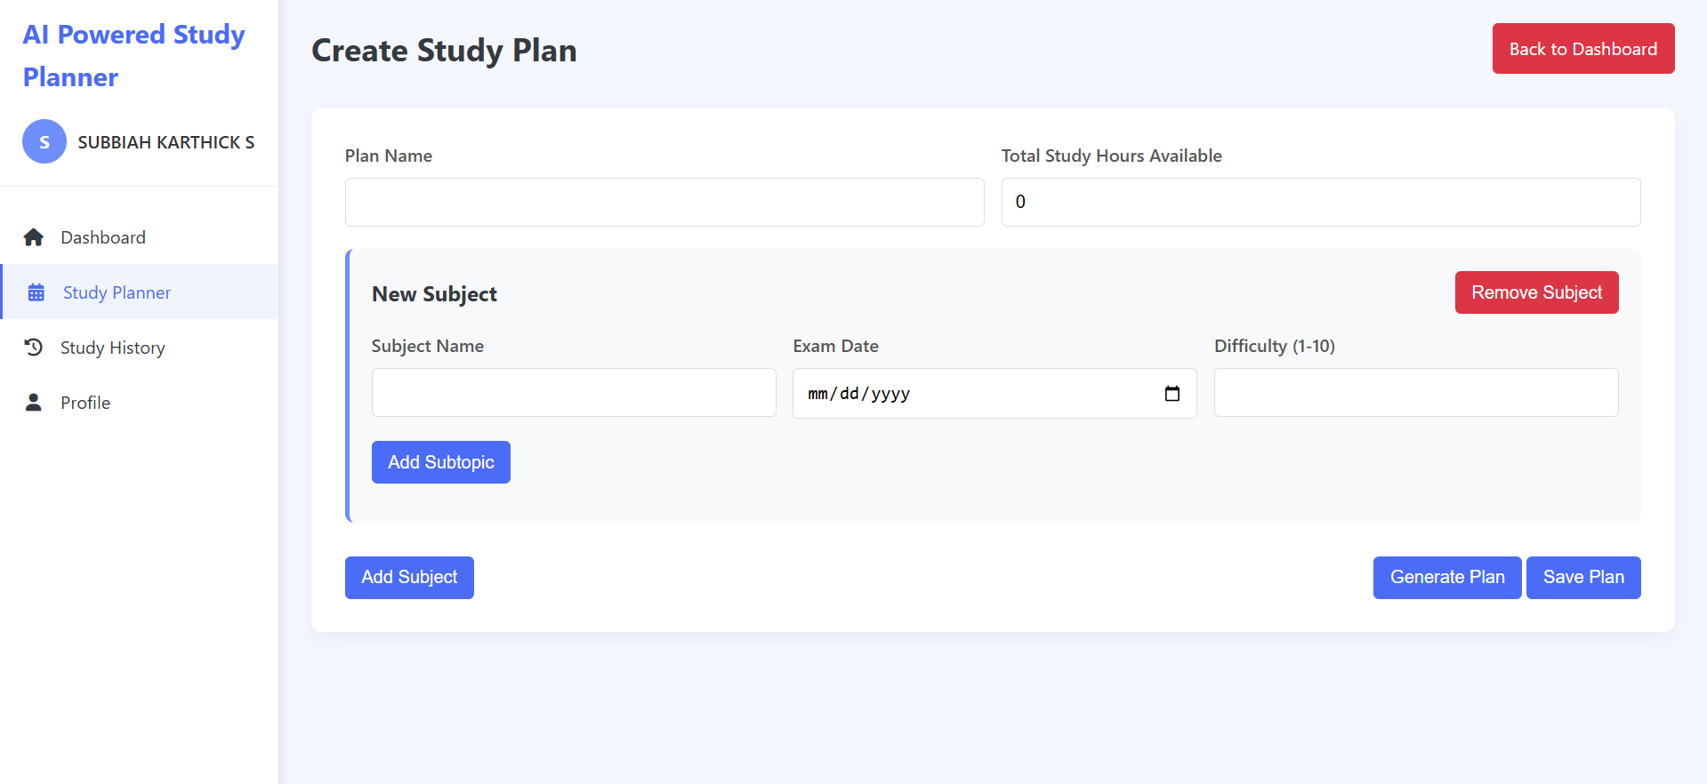
OUTPUT
11/06/2025

Slide 18
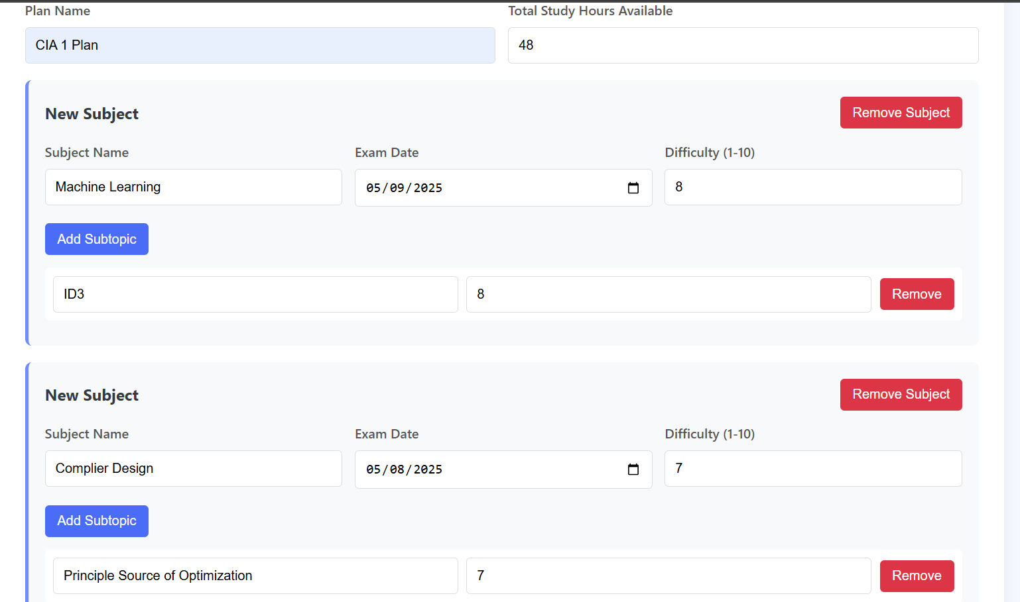
OUTPUT
11/06/2025

Slide 19
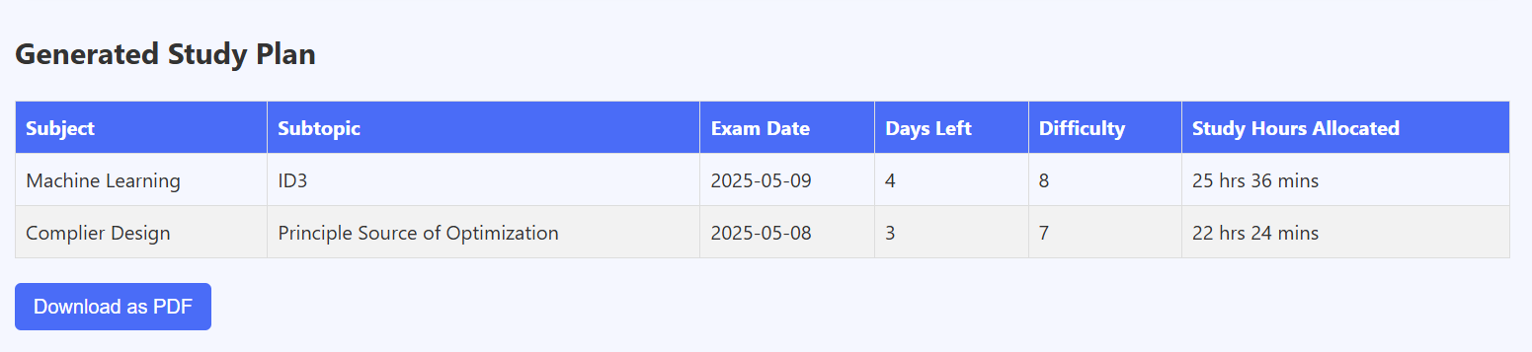
OUTPUT
11/06/2025

Slide 20
CONCLUSION & FUTURE ENHANCEMENT
Adaptive Learning Schedule:
Implement machine learning to adjust the study plan in real-time based on user progress and performance.
Third-Party Integration:
Connect with platforms like Google Calendar, YouTube, or e-learning portals for automatic content and time sync.
Smart Notifications & Reminders:
Use AI to send motivational tips, optimized break alerts, and subject revision reminders based on user behavior.
11/06/2025

Slide 21
REFERENCES
R. Sharma and A. Singh, “Smart education system using AI and data visualization,” International Journal of Advanced Computer Science and Applications, vol. 13, no. 6, pp. 198–205, 2022.
S. B. Gupta and M. Verma, “Optimizing Study Time with AI-Driven Academic Planners,” Journal of Intelligent Learning Systems and Applications, vol. 14, no. 1, pp. 45–58, 2022.
Ibrahim Mahmood Ibrahim, Subhi R.M. Zeebaree, Mohammed A.M. Sadeeq, A.H. Radie, Zryan Najat Rashid, "Task Scheduling Algorithms in Cloud Computing," Turkish Journal of Computer and Mathematics Education (2021).
11/06/2025

Slide 22

11/06/2025

